Slide 1
HIGHWAY VECHICLE ACCIDENT IDENTIFICATION AND AUTO COMMUNICATION TO PATROL & HOSPITAL

Slide 2
ABSTRACT:
In our project deals design a road accident identification with auto SMS system. This is very useful system for high way department. In this system every vehicle is featured with accident sensor and transmitter module. If there is any collision between vehicles, the transmitters send the signal to nearer receiving tower.
In receiving tower, the auto SMS system information about accident to police station, hospital and relief squad. The remote process is done using ISM 433.92 MHz module. The microcontroller is mainly used for the SMS selection. Here we are using Arduino micro controller. The port lines are connected to the GSM MODEM.

Slide 3
EXISTING SYSTEM
No automatic accident detection and alert system

Slide 4
PROPOSED SYSTEM
In proposed system if a vehicle has met accidents, immediately an alert message is sent to the Control center. From the control center, a message is sent to the nearby ambulance. Also signal is transmitted to all the signals in between vehicle and controller section

Slide 5
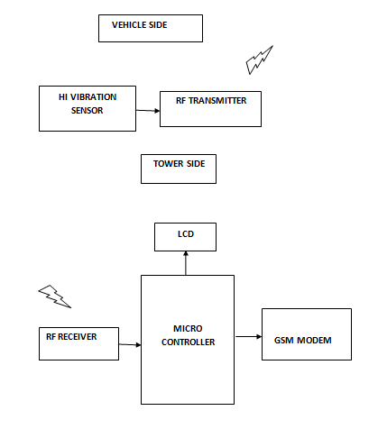
Block Diagram:

Slide 6
HARDWARE'S
Arduino
RF Module
LCD Display
GSM Modem

Slide 7
SOFTWARE'S
Arduino IDE
Language – Embedded C

Slide 8
Advantages:
Alert will be send automatically
Rescue operations made immediately

Slide 9
Applications:
Rescue systems

